Slide 1

Electronic Devices
Lab Lecture 4
This document might contain some excerpts and pictures from various books and other sources. The author doesn’t claim any rights to the topics discussed in this video. This topics has been presented in a way to help out students in BRAC university, Bangladesh

Slide 2
Digital to Analog Converter
A digital to analog converter (DAC) converts a digital signal from the computer into an electrical voltage which can be used to drive electrical equipment
There can be many types of digital to analog converter.
In this experiment we will learn about two types of Digital to analog converter.
Binary-Weighted Digital to Analog Converter.
R and 2R Digital to Analog Converter
`

Slide 3
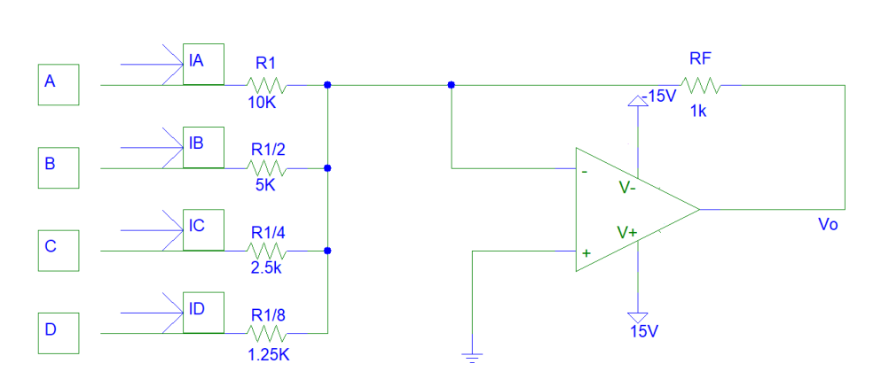
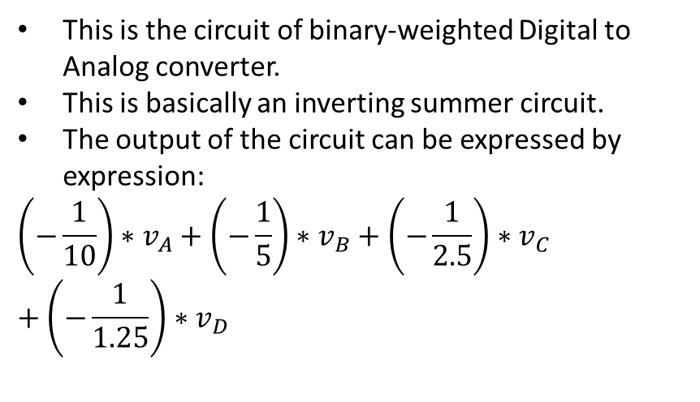
Binary-Weighted Digital to Analog Converter
This is the circuit of binary-weighted Digital to Analog converter.
This is basically an inverting summer circuit.
The output of the circuit can be expressed by expression:
$$\left(−\frac{1}{10}\right)∗v_{A}+\left(−\frac{1}{5}\right)∗v_{B}+\left(−\frac{1}{2.5}\right)∗v_{C}+\left(−\frac{1}{1.25}\right)∗v_{D}$$

Slide 4
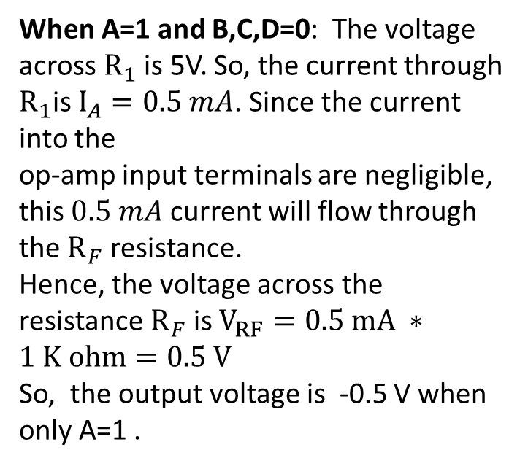
Binary-Weighted Digital to Analog Converter
When A=1 and B,C,D=0: The voltage across $R_{1}$ is 5V. So, the current through $R_{1}$is $I_{A}=0.5 mA$. Since the current into the
op-amp input terminals are negligible, this $0.5 mA$ current will flow through the $R_{F}$ resistance.
Hence, the voltage across the resistance $R_{F}$ is $V_{RF}=0.5 mA ∗1 K ohm=0.5 V$
So, the output voltage is -0.5 V when only A=1 .

Slide 5
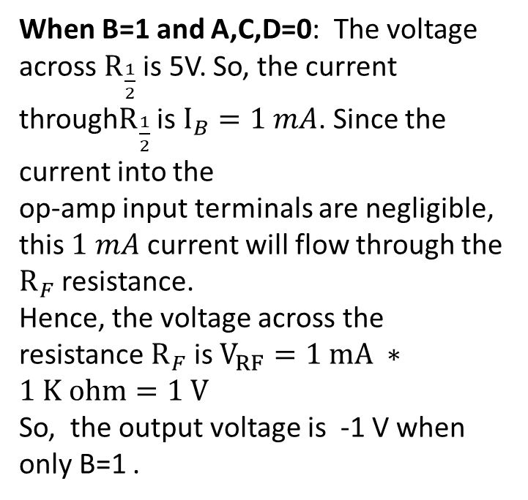
Binary-Weighted Digital to Analog Converter
When B=1 and A,C,D=0: The voltage across $R_{\frac{1}{2}}$ is 5V. So, the current through$R_{\frac{1}{2}}$ is $I_{B}=1 mA$. Since the current into the
op-amp input terminals are negligible, this $1 mA$ current will flow through the $R_{F}$ resistance.
Hence, the voltage across the resistance $R_{F}$ is $V_{RF}=1 mA ∗1 K ohm=1 V$
So, the output voltage is -1 V when only B=1 .

Slide 6
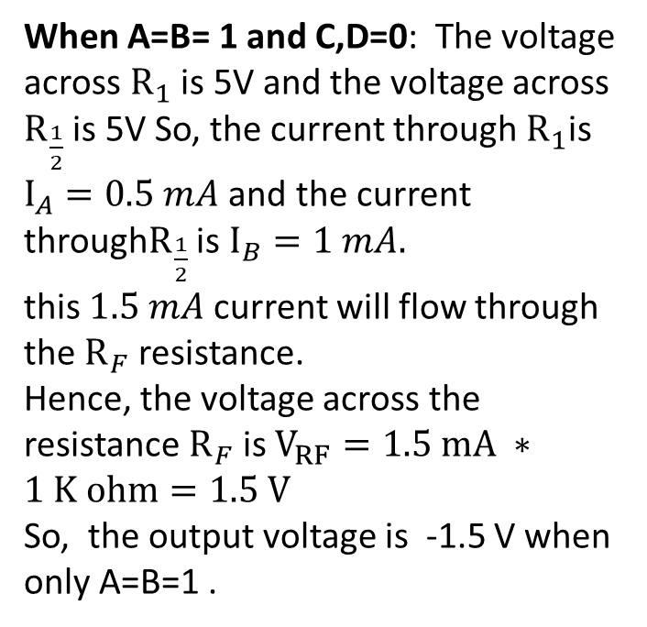
Binary-Weighted Digital to Analog Converter
When A=B= 1 and C,D=0: The voltage across $R_{1}$ is 5V and the voltage across $R_{\frac{1}{2}}$ is 5V So, the current through $R_{1}$is $I_{A}=0.5 mA$ and the current through$R_{\frac{1}{2}}$ is $I_{B}=1 mA.$
this $1.5 mA$ current will flow through the $R_{F}$ resistance.
Hence, the voltage across the resistance $R_{F}$ is $V_{RF}=1.5 mA ∗1 K ohm=1.5 V$
So, the output voltage is -1.5 V when only A=B=1 .

Slide 7
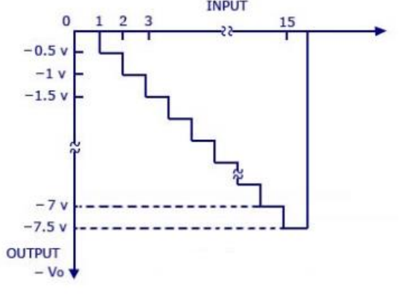
Binary-Weighted Digital to Analog Converter
The output is a negative going staircase waveform with 15 steps of -0.5V each.
The value of the feedback resistor RF changes the size of the steps. Thus, a desired size for a step can be obtained by connecting the appropriate feedback resistor.
The only condition to look out for is that the maximum output voltage should not exceed the saturation levels of the op-amp

Slide 8
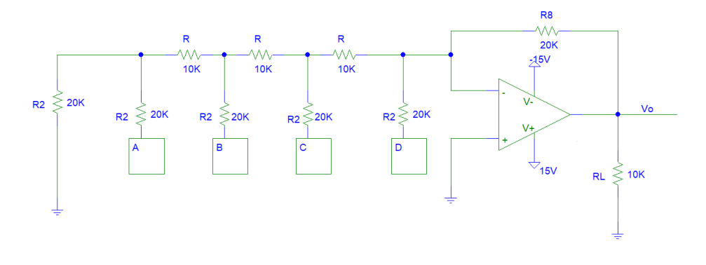
R and 2R Digital to Analog Converter
The previous DAC converter has one serious problems, the resistor values, if the values are not exact, it will give wrong voltage values.
R and 2R DAC converter has no such problem because it only uses 2 values of resistors, R and 2R when R can be of any value.
This circuit can be solved by superposition or source transformation or thevenin equivalent

Slide 9
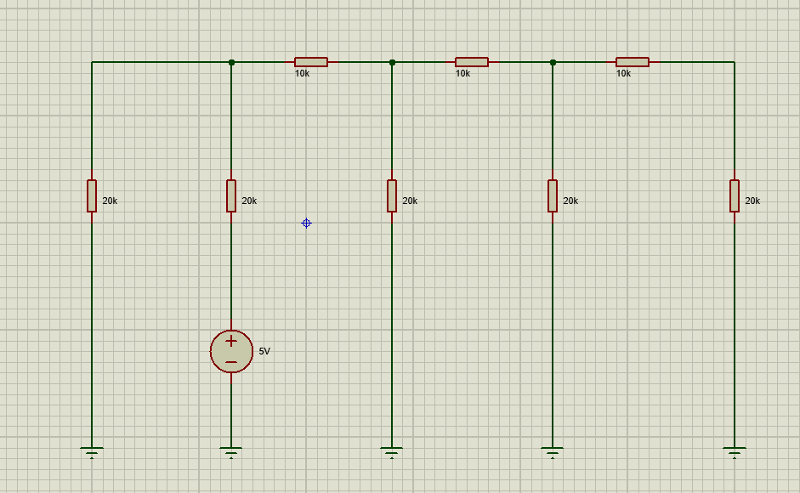
R and 2R Digital to Analog Converter
Assume only A has high value and other inputs have value of logic 0

Slide 10
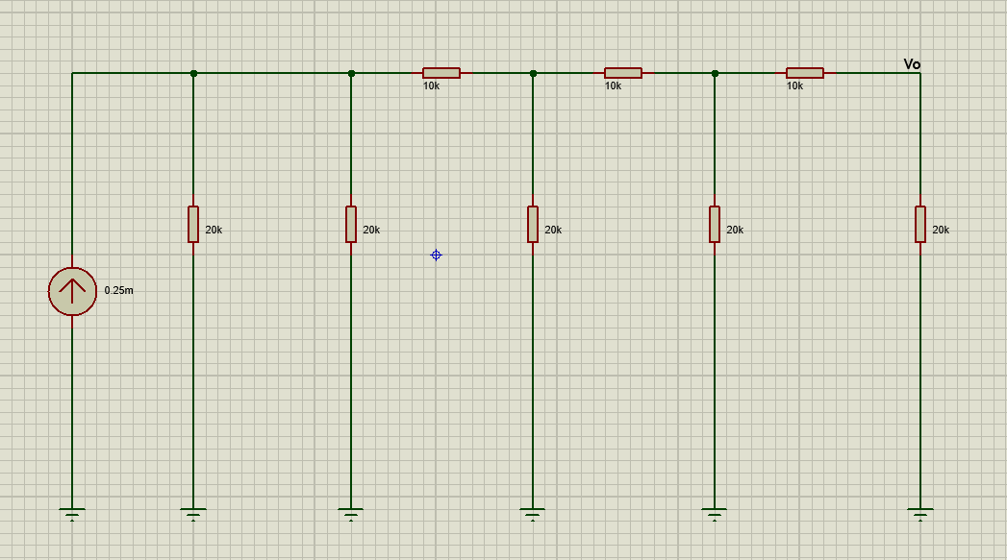
R and 2R Digital to Analog Converter
Now we apply source transformation continuously. 5v voltage source will become 0.25 mili ampere current source

Slide 11
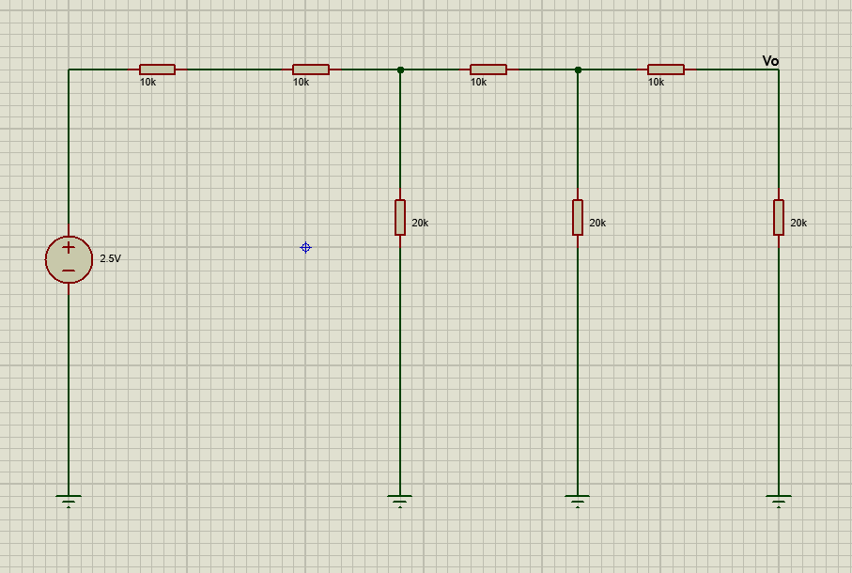
R and 2R Digital to Analog Converter
2 20k ohm resistors are connected in parallel and they result in a single 10k ohm resistors. Then applying a source transformation will result in a voltage source of a value of 2.5 volt

Slide 12
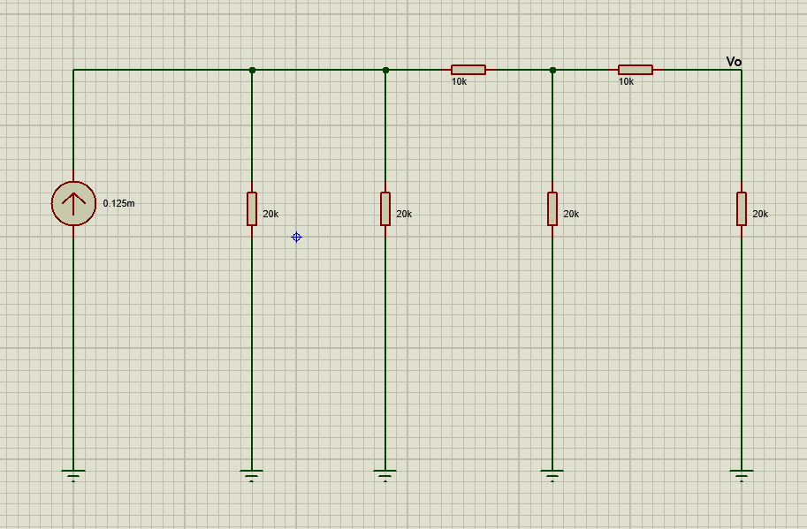
R and 2R Digital to Analog Converter
Once again we applied source transformation. 2.5 voltage source will be converted to 0.125 mili ampere current source and there will be 2 20 kilo ohm resistors in parallel.

Slide 13
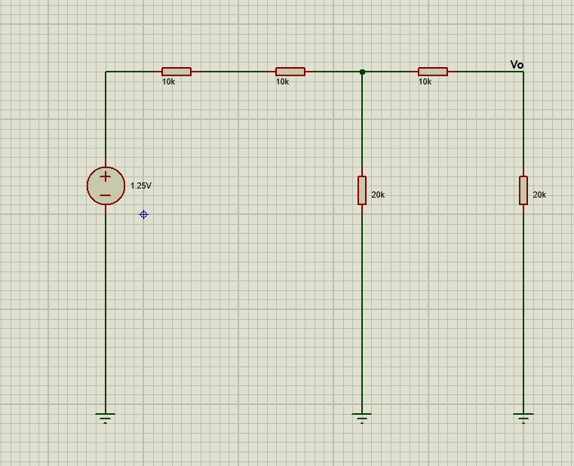
R and 2R Digital to Analog Converter
2 20k ohm resistors are connected in parallel and they result in a single 10k ohm resistors. Then applying a source transformation will result in a voltage source of a value of 1.25 volt

Slide 14
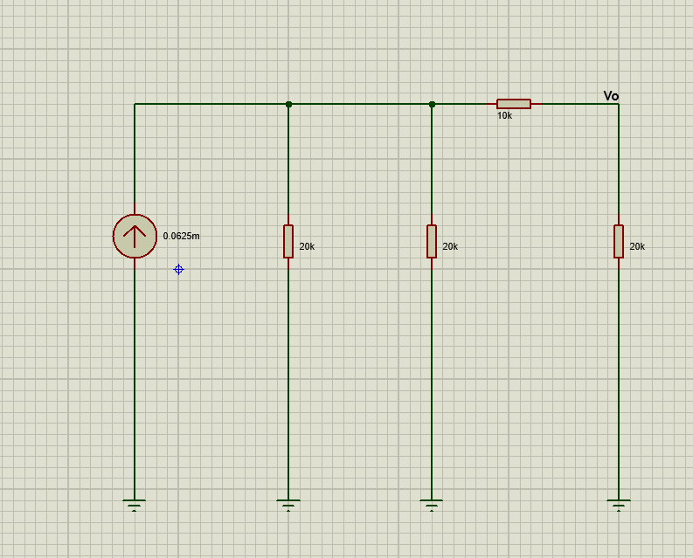
R and 2R Digital to Analog Converter
2 10k ohm resistors are connected in series and they result in a single 20k ohm resistor. Once again we applied source transformation.

Slide 15
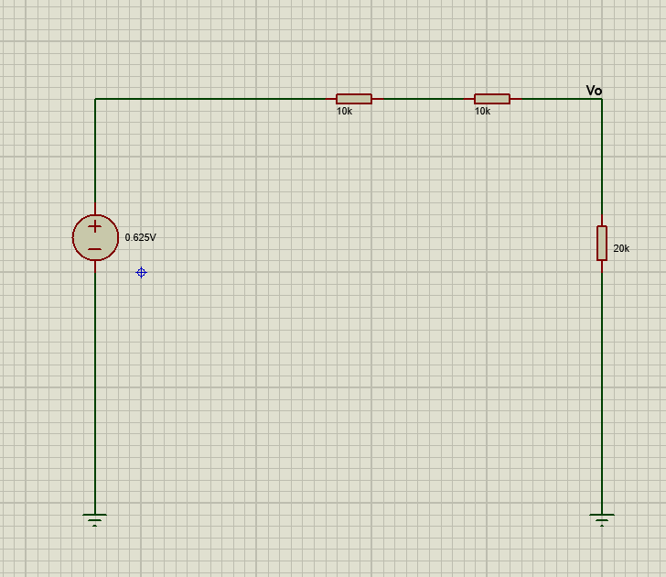
R and 2R Digital to Analog Converter
2 20k ohm resistors are connected in parallel and they result in a single 10k ohm resistors. Then applying a source transformation will result in a voltage source of a value of 0.625 volt
Now , if you apply a specific op amp formula you will get the same analog output value as you got in the simulation. What will be this formula ???

Slide 16
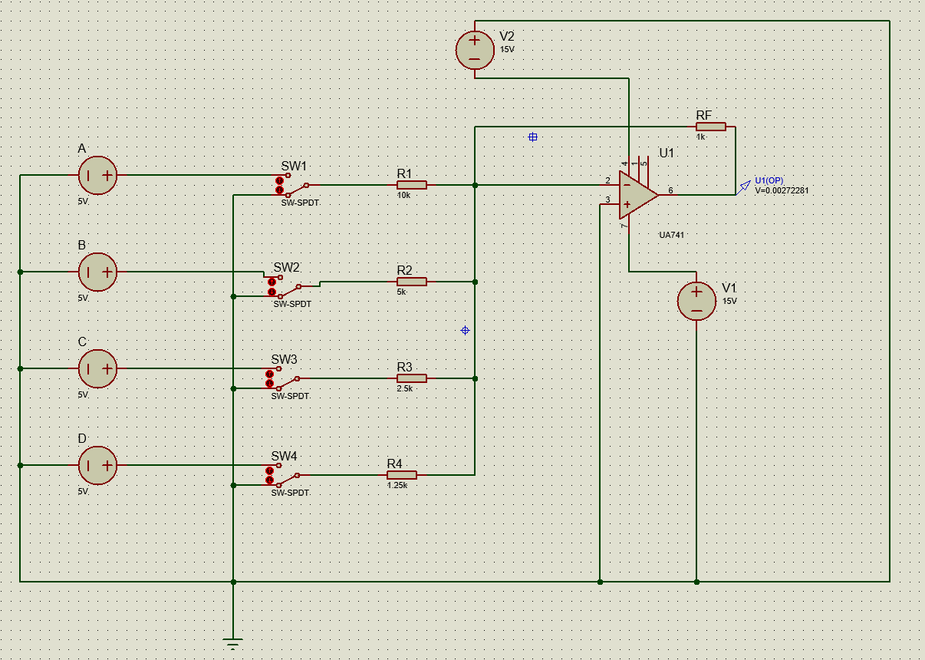
Simulation
Figure : Schematic of Binary Weighted Digital to Analog Converter

Slide 17
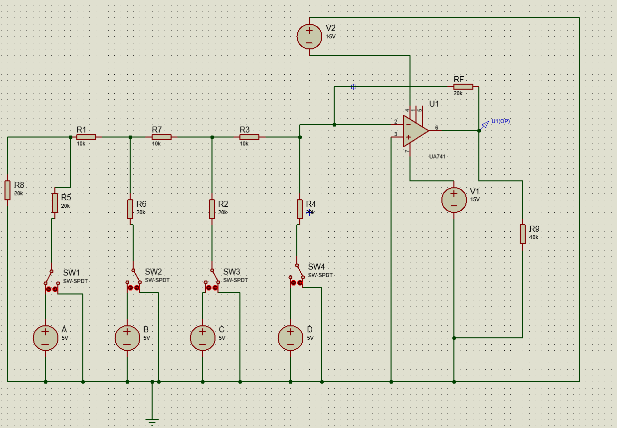
Simulation
Figure : Schematic of R and 2R Digital to Analog Converter

